Slide 1
Week 1 Review and Discussion

Slide 2
Neural Network (AI/ Deep Learning)
Rule-based (Expert Systems)
AI
Machine Learning (Data mining)
1950s
1970s
1990s
2010s

Slide 3

What is AI?
Different people have different definitions.
Computer scientists
Strictly Neural Net
Business people
Machines that can make decisions.
Different periods of time
1990s:
AI means neural network
Classic machine learning guys do not want to associate them as “AI” guys
2020s
AI means everything (as long as machines can think)
Classic machine learning guys proudly tell people that they are doing “AI”

Slide 4
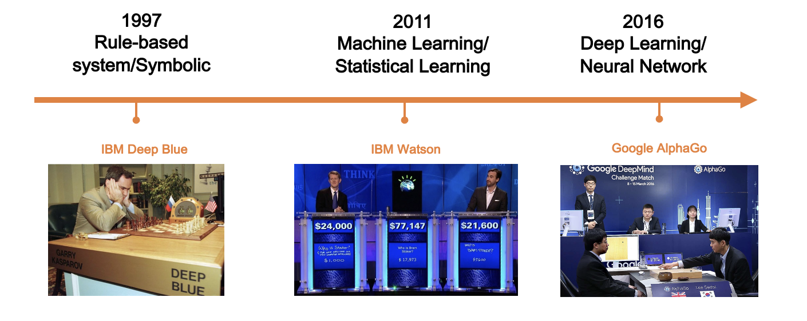
What are the three major types of AI in the business world
Rule based
Classic machine learning based
Deep learning based

Slide 5
What are the pros and cons of rule-based AI compared to machine learning based AI?
Pros:
Clearly defined, transparent
Easy and fast to develop
Cons:
The rules are too limited for the complex world
Rule-based AI cannot learn by itself – it has to be fed by humans

Slide 6
What is “Feature” in machine learning? What is feature engineering?
Feature is simply the input to the machine learning model, such as the X variables in a logistic regression.
Feature engineering is the process to curate the raw data into input suitable for machine learning models.

Slide 7
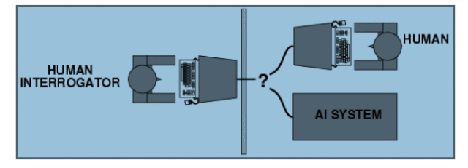
What is the famous Turing Test?
It is a “thought experiment” proposed by Alan Turing in 1950.
It is used to assess the level of intelligence of the machine:
If an evaluator cannot tell whether the answer is from human or AI, then AI passes the Turing test.
The Turing test is “task” specific

Slide 8
Can you give an example of a machine that passed the Turing Test in your life?
Facial recognition
Bank account Chatbot
Autopilot in airplanes
Writing summary
Create a template for a proposal
And many more…

Slide 9


Why is the Turing Test often cited in the major media?
If an AI passes the Turing test for that task, it can replace human workers to do that task.
It leads to the worries of what place humans can still hold in the AI-era.

Slide 10


These days, why might the Turing test be misleading in AI development?
It emphasizes on mimicking human output, rather than complementing human and AI.
We need to develop AI to collaborate with humans rather than replacing humans.

Slide 11
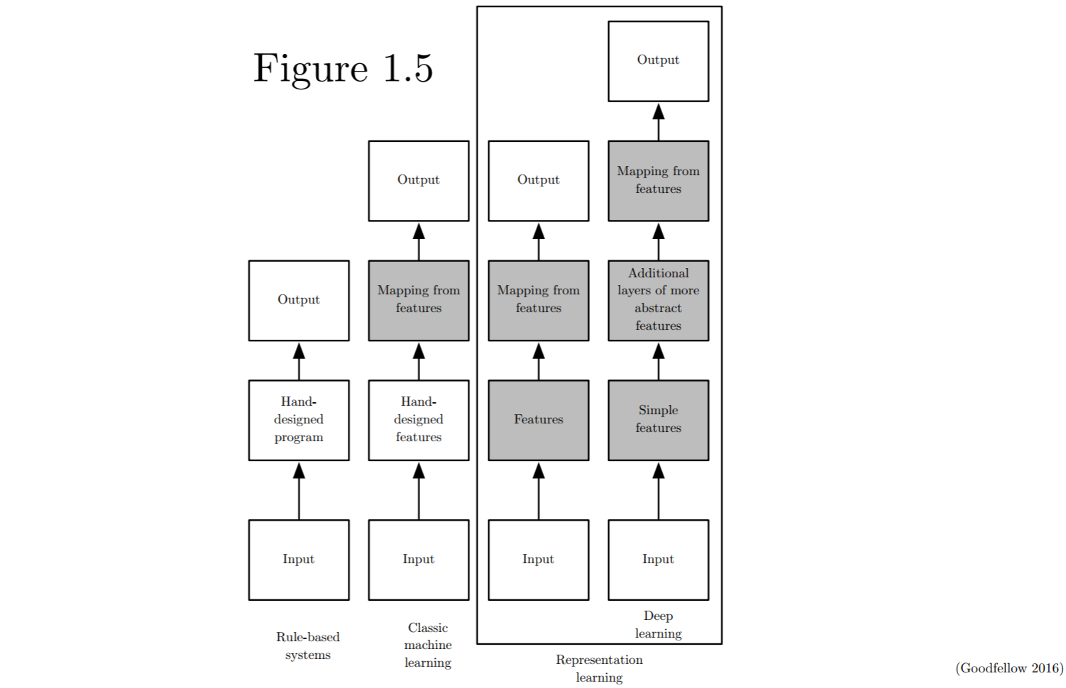




From an academic perspective, what is the relationship between machine learning and Deep learning?
Deep learning is part of the broader machine learning
Deep learning is different than the classic machine learning
Shaded boxes indicate learning from data (rather than hand-designed)

Slide 12
When you hear people saying “we are using both machine learning and AI in our business”,
what do they mean by “machine learning” in this context?
The classic machine learning such as clustering, decision tree, and logistic regression. But not rule-based or deep learning
What do they mean by AI in this context?
Deep Learning/ Neural Network

Slide 13

Who has predicted and planned the rise of deep learning in the 2010s?
Facebook
Google
IBM
Microsoft
None of them

Slide 14

Why AI now?
Driven by three forces
Advances in algorithm
Esp. Geoffrey Hinton
Advances in computing
Esp. GPU
Advances in Big Data
Esp. Hadoop

Slide 15
Assignment 1
What are Elon Musk’s main points?
Do you agree?
What are Matt Garman (AWS CEO)’s main points?
Do you agree?

Slide 16
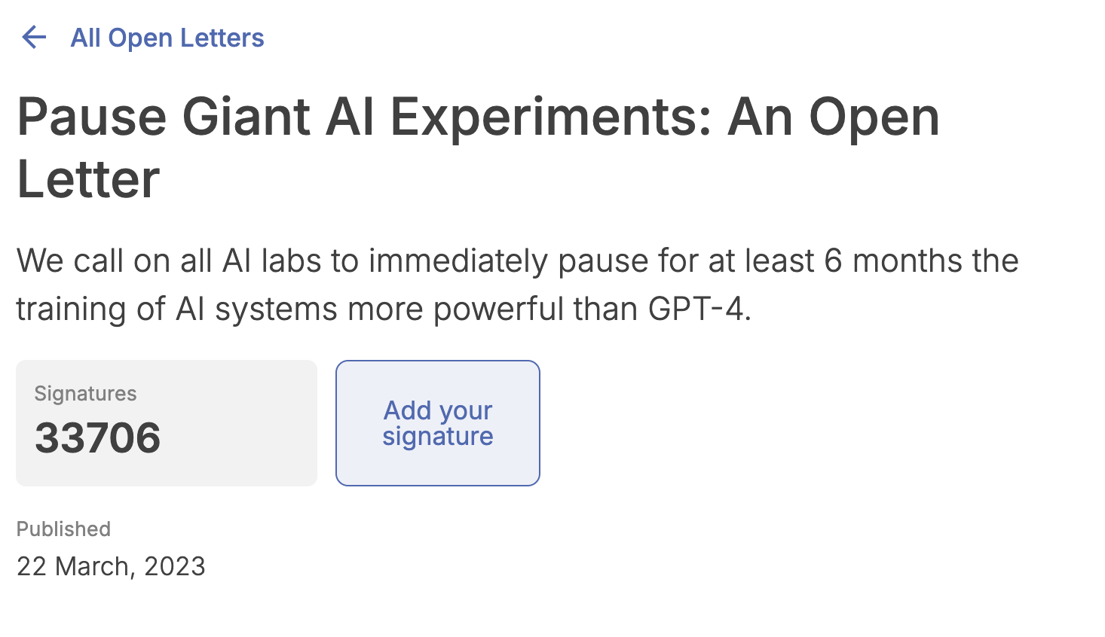
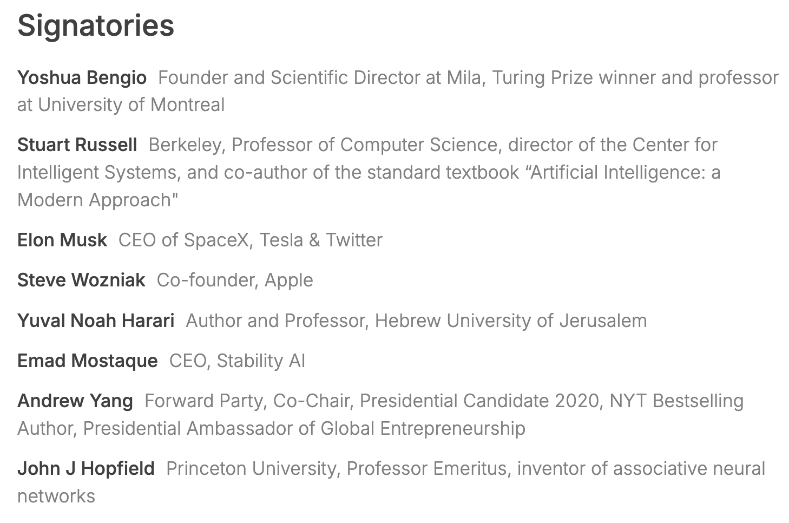
https://futureoflife.org/open-letter/pause-giant-ai-experiments/

